Slide 1



Pemrograman Visual
Working With Forms
6

Slide 2
Working With Forms
Tujuan Pembelajaran
Mahasiswa dapat membuat dan menampilkan form baru
Mahasiswa dapat membuat ulang Forms
Mahasiswa dapat membuat kustom dialog

Slide 3
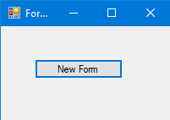
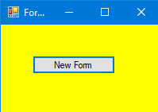

New Forms

Slide 4

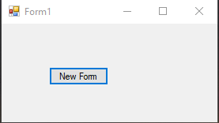
Create Object Forms

Slide 5
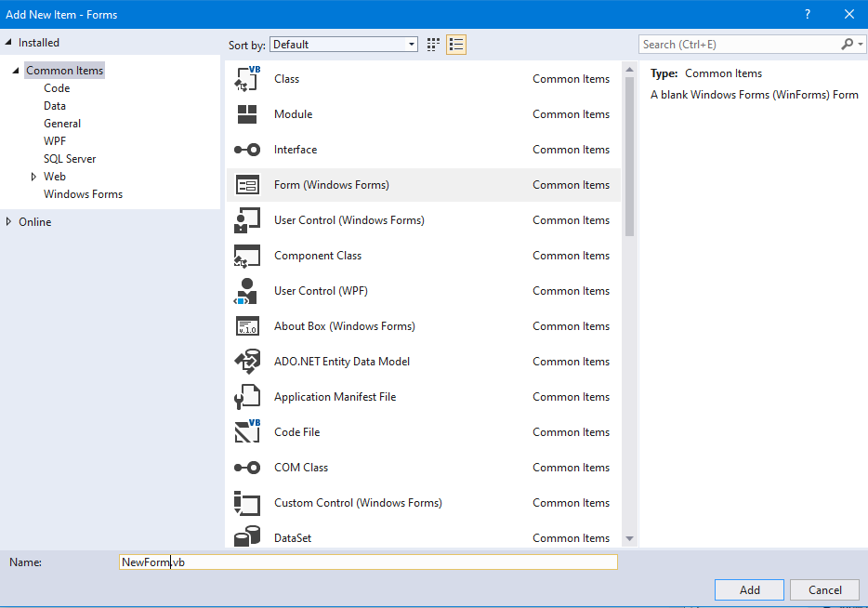
Create Object Forms
To Add Form, you can use toolbar menu
Klik Project
Add Form (Window
Form)

Slide 6

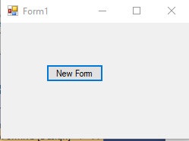
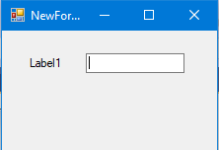
Call New Form

Slide 7

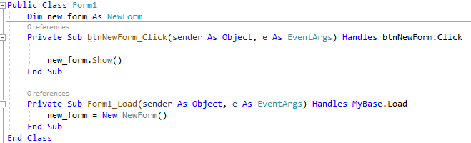
Re-Using Forms
Only one instance form will be created

Slide 8

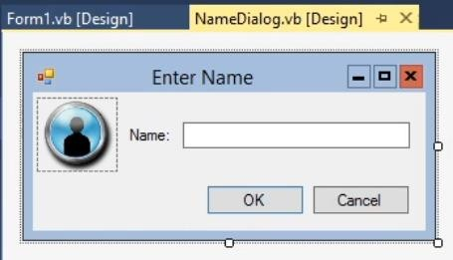
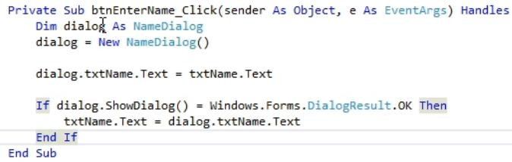
Building Custom Dialog

Slide 9
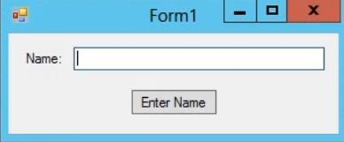
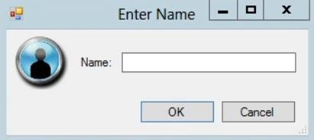
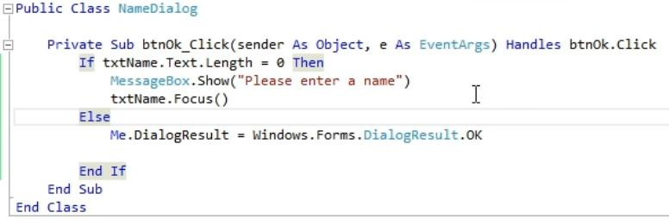
Building Custom Dialog

